Slide 1

Starbucks Company
Name
Institution

Slide 2
Introduction to the firm
Starbucks Corporation is a company that was established in America in 1971.
At the beginning, it was initiated in Seattle in Washington, but later expanded in over thirty thousand locations globally.
The main products produced by the company include coffee beverages, tea, baked goods and smoothies.
The major customers targeted by the company are the high income earners in all the outlets (Tucker, 2017).
The company segments its market according to the targeted groups worldwide.

Slide 3
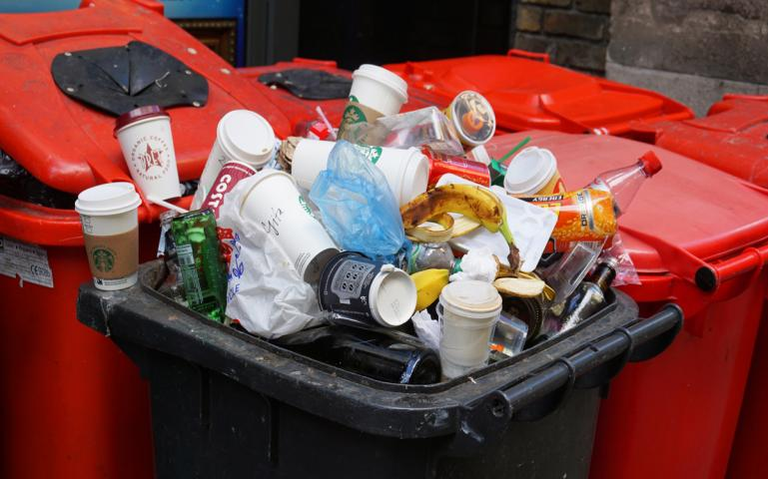
The unethical behavior
Environmental concerns have been one of the major unethical issue in Starbucks Company.
The company has been wasting over twenty three million liters of water in the United Kingdom and United States everyday.
The firm has also been using more than six kilowatts of electricity per month.
The respective States where the firm operates have been raising the concerns frequently.
Energy and water related organizations have also been requesting the management of the company to minimize the wastage.

Slide 4
How the company responded
From the continuous concerns, the management of Starbucks Company accepted the mistakes.
The concerned departments promised to work on the wastage of resources.
The firm admitted that it has the responsibility of keeping the environment clean and avoiding wastage.
During the company’s tenth annual global responsibility meeting, water conservation was raised as one of the main agenda.
Recently, the firm has been recording positive changes in environmental concerns.

Slide 5
Short-term and long-term effects
One of the short-term effects of environmental pollution is a negative health effect to employees’ health.
The firm can also lose customers due to poor reputation.
The company can end up using unbudgeted resources in correcting the mistakes.
Law suits may be some of the long term effects of environmental mismanagement by the firm.
When the concerned organizations sue the company for pollution, the management may end up wasting resources in handling the court affairs.

Slide 6
Why customers really care
Customers prefer companies that comply with the authorities.
A reputation of the firm determines the growth and development of an organization in terms of sales.
Wastage of water may limit the amount of water reaching the residents neighboring the company.
Improper disposal of plastics and waste from coffee processes may affect the health of customers visiting the firm (Campbell & Helleloid, 2016, p38).
Mismanagement of waste can interfere with the quality Starbucks Company.

Slide 7
The cause-related marketing campaign
Starbucks and World AIDS Day is one of the cause-related marketing campaign.
The campaign helps in fighting against AIDS.
Starbucks donates some money towards the global programs.
Some funds are offered to coffee growing societies especially in Africa to support treatment of the disease.
Cause-related marketing campaigns improved the social responsibilities of companies (He et al., 2016, p256).
Since the partnership started, the company has donated over fourteen million Dollars to support the campaign.

Slide 8
Short-term and long-term effects
One of the short-term effect of the campaign towards the company is increased revenue.
Giving back to the society improves the loyalty of the firm to the customers in the long run.
The customers care about the initiatives by any firm in support of the needy people in the society.
If I was given an opportunity to run manage the campaign, I would consider people’s views before allocating funds for donation (Akgun et al., 2017. p70).
Starbucks will achieve its corporate goals if the management maintain the efforts in initiatives and

Slide 9
References
Tucker, C. M. (2017). Coffee culture: Local experiences, global connections. Routledge.
Campbell, K., & Helleloid, D. (2016). Starbucks: Social responsibility and tax avoidance. Journal of Accounting Education, 37, p38-60.
Akgun, A. E., Keskin, H., Ayar, H., & Etlioglu, T. (2017). Why companies go positive marketing innovations: A new theoretical prototype for 4PS of innovation. Journal of Business Economics and Finance, 6(2), p70-77.
He, H., Zhu, W., Gouran, D., & Kolo, O. (2016). Moral identity centrality and cause-related marketing. The moderating effects of brand social responsibility image and emotional brand attachment. European journal of Marketing, 50(1/2), pp236-259.

